Slide 1
A Comparative Study of GPS and Bluetooth Speed Data on Man O War Boulevard
Jacob Brashear

Slide 2
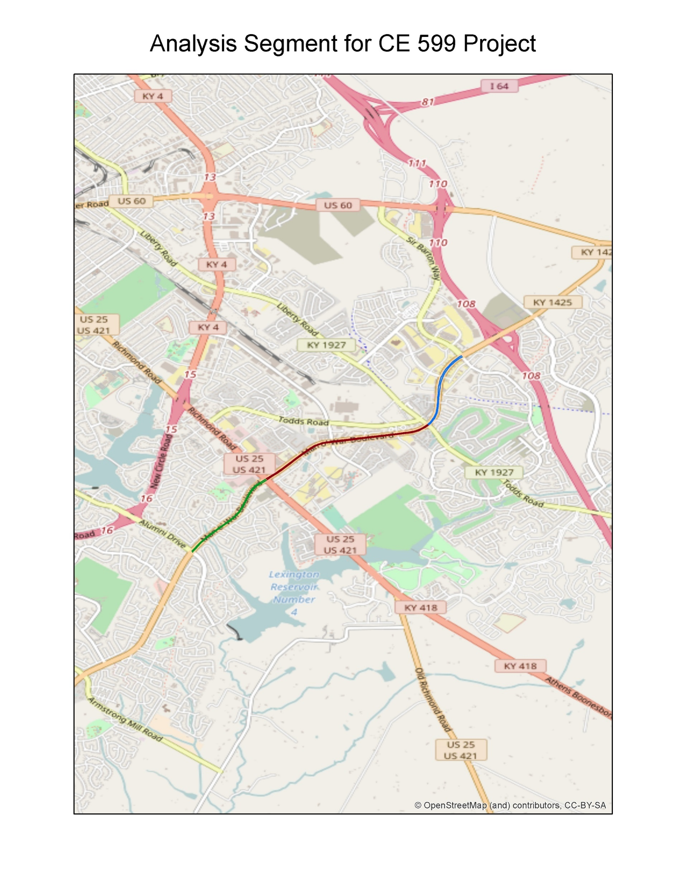

Slide 3
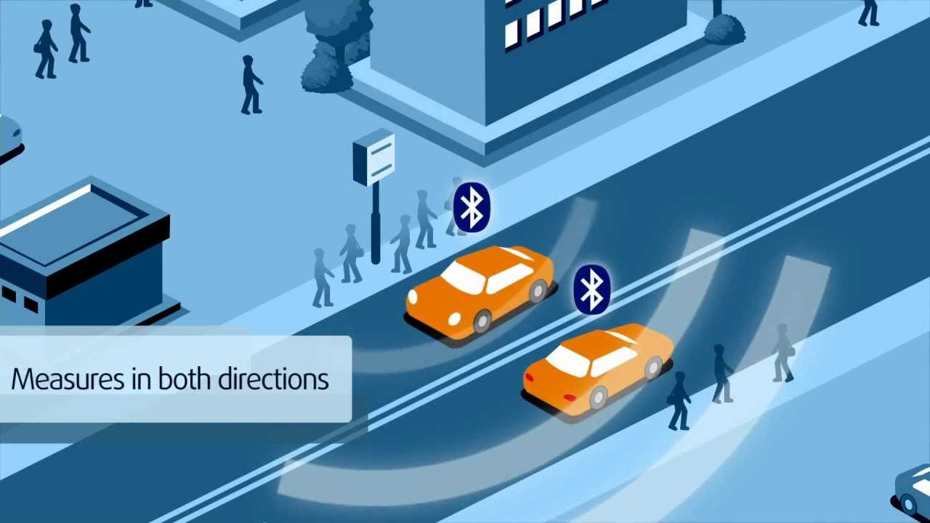
What are the Differences?
Bluetooth – Uses Bluetooth Sensors in phones and other devices to track and monitor traffic

Slide 4
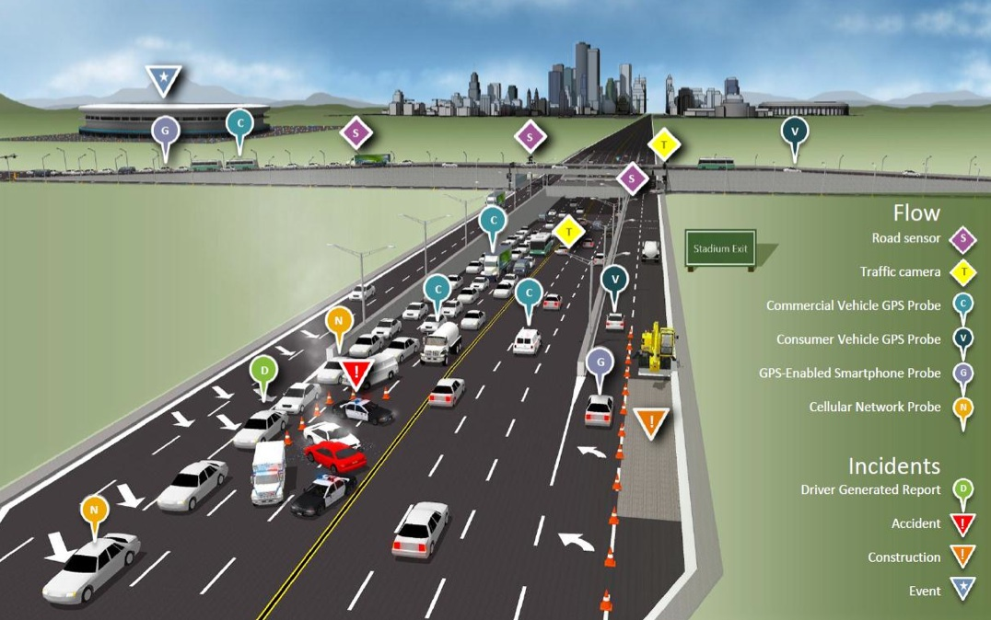
What are the Differences?
GPS: Uses GPS devices and smartphones to monitor speed

Slide 5
The Datasets
Year: 2015
Bluetooth: Gives 5-minute speed data along segments on Man O War Blvd (eg. Richmond road to Alumni Drive)
GPS: 5-Minute speed data along various links
Path-Based GPS
Point-Based GPS

Slide 6
Goals
Develop a process to convert GPS data over to corridor-level speeds comparable to Bluetooth data
Perform basic comparisons to see how the data compares to each other
Compare the strengths and weaknesses of the data collection methods and relate the findings to the speed data collected along Man O War
Come up with a quicker way to calculate HERE Statistics than what is currently Implemented.

Slide 7
Development of Datasets: Python and Excel
Research: “Analysis of Historical Travel Time Data”
Performance metrics from this paper adapted into python code and calculated by link for HERE data and by segment for Bluetooth data
Used GIS to create tables containing HERE links by segment.
Used GIS data to create segment-level HERE stats by joining HERE Link statistics to GIS links.
Statistics were re-calculated on a weighted average with respect to HERE Link Lengths
Used excel to combine HERE Segment and Bluetooth Segment data for comparisons
Created Pairplots using Seaborn

Slide 8
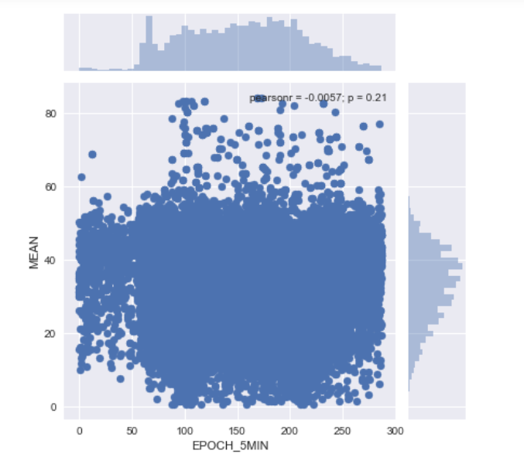
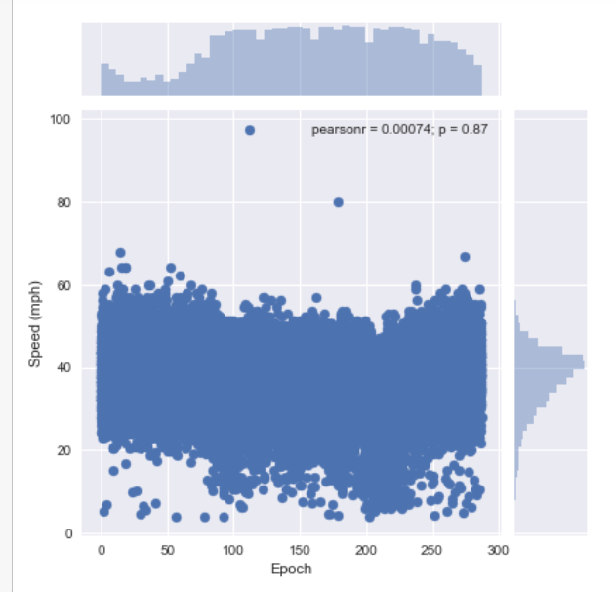
Pairplots: Richmond Road to Alumni
HERE
Bluetooth

Slide 9
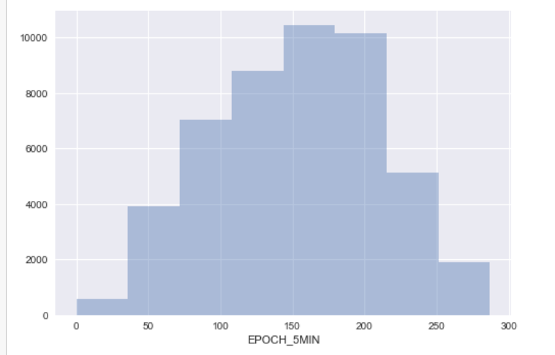
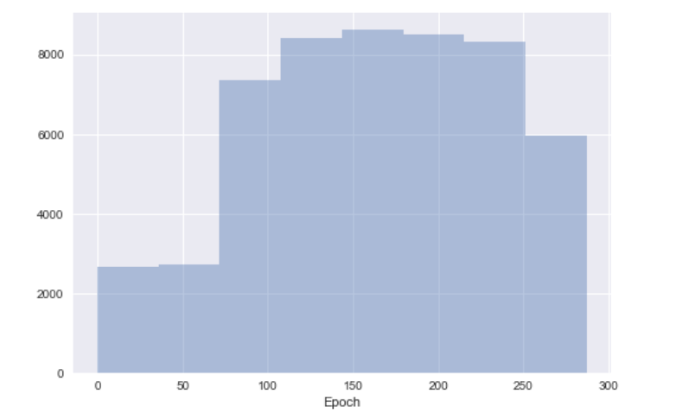
Pairplots: Richmond Road to Alumni
HERE
Bluetooth

Slide 10
Comparisons
Mean Speed
Standard Deviation
% Coverage
85th percentile speed
5th percentile speed
60th percentile speed
TTI
PTI
BTI (Buffer Index)
Pair plots between Mean and Epoch (5-min intervals)

Slide 11
Richmond Road to Alumni
Notes:
Pct Intervals for HERE is by link. Pct Intervals for Bluetooth is by segment
HERE 60th speed is calculated between 6AM and 8PM

Slide 12
Richmond Road to Alumni
Notes:
Notice how different PIT and BTI are between HERE and Bluetooth?

Slide 13
Conclusions

Slide 14


